Slide 1
Objectives
In this session, you will learn to:
  Identify the features of a stack
  Implement stacks
  Apply stacks to solve programming problems

Slide 2
What is a Stack ?
A stack is a collection of data items that can be accessed at only one end, called top.
Items can be inserted and deleted in a stack only at the top.
The last item inserted in a stack is the first one to be deleted.
Therefore, a stack is called a Last-In-First-Out (LIFO) data structure.
It is also known as restricted linear list.

Slide 3
Identifying the Operations on Stacks
There are two basic operations that are performed on stacks:
  PUSH
  POP
PUSH: It is the process of inserting a new element on the top of a stack.
Push an
Element 1
Empty Stack
1

Slide 4
Identifying the Operations on Stacks (Contd.)
PUSH: It is the process of inserting a new element on the top of a stack.
Push an
Element 2
Push an
Element 3
3
2
1

Slide 5
Identifying the Operations on Stacks (Contd.)
POP: It is the process of deleting an element from the top of a stack.
POP an
Element
POP an
Element
3
3
2
2
1

Slide 6
Just a minute
Elements in stacks are inserted and deleted on a ___________ basis.
Answer:
  LIFO

Slide 7
Just a minute
List down some real life examples that work on the LIFO principle.
Answer:
  Pile of books: Suppose a set of books are placed one over the other in a pile. When you remove books from the pile, the topmost book will be removed first. Similarly, when you have to add a book to the pile, the book will be placed at the top of the pile.
  Pile of plates: The first plate begins the pile. The second plate is placed on the top of the first plate and the third plate is placed on the top of the second plate, and so on. In general, if you want to add a plate to the pile, you can keep it on the top of the pile. Similarly, if you want to remove a plate, you can remove the plate from the top of the pile.
  Bangles in a hand: When a person wears bangles, the last bangle worn is the first one to be removed.
Notes:
In this slide you need to show the calculation to determine the sum of an arithmetic progression for bubble sort algorithm. Refer to student guide.

Slide 8
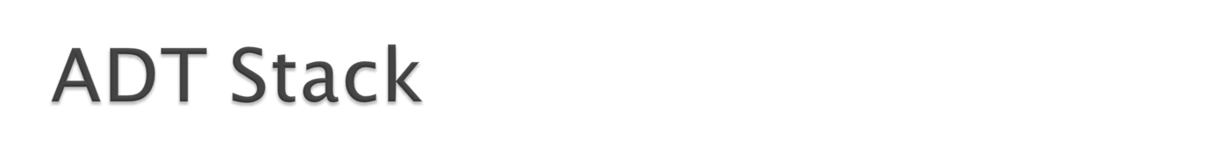
Class stack
{finite ordered list with 0 or more elements.
int top;
Public:
stack();//create an empty stack and initializes top;
void push( ele);//to insert element into stack;
void pop();//to remove element from stack;
int top();//returns value of top
Isempty();//check wheather stack is empty or not
Isfull();
}

Slide 9
Implementing a Stack Using an Array
IMPLEMENTATION OF STACK
stack can be implemented using
1)arrays (STATIC IMPLEMENTATION)
2)linked lists.(DYNAMIC IMPLEMENTATION)
To implement a stack using an array:
  Declare an array:
  int Stack[5]; // Maximum size needs to be specified in // advance
  Declare a variable, top to hold the index of the topmost element in the stacks:
  int top;
  Initially, when the stack is empty, set:
  top = –1
Notes:
Tell students that stacks can be implemented using both arrays and Linked List. The slides to explain the implementation of stacks using an array are given.

Slide 10
Implementing a Stack Using an Array (Contd.)
Let us now write an algorithm for the PUSH operation.
Initially:
top = – 1
PUSH an element 3
0
1
2
3
4
Stack

Slide 11
Implementing a Stack Using an Array (Contd.)
top = – 1
PUSH an element 3
0
1
2
3
4
Stack
10

Slide 12
Implementing a Stack Using an Array (Contd.)
top = 0
PUSH an element 3
0
1
2
3
4
Stack
10
top = 0

Slide 13
Implementing a Stack Using an Array (Contd.)
PUSH an element 3
0
1
2
3
4
Stack
3
Item pushed
10
10
top = 0

Slide 14
Implementing a Stack Using an Array (Contd.)
PUSH an element 8
0
1
2
3
4
Stack
3
10
10
top = 0

Slide 15
Implementing a Stack Using an Array (Contd.)
PUSH an element 8
0
1
2
3
4
Stack
3
10
10
top = 0
top = 1

Slide 16
Implementing a Stack Using an Array (Contd.)
PUSH an element 8
0
1
2
3
4
Stack
3
8
Item pushed
10
10
top = 1

Slide 17
Implementing a Stack Using an Array (Contd.)
PUSH an element 5
0
1
2
3
4
Stack
3
8
10
10
top = 1

Slide 18
Implementing a Stack Using an Array (Contd.)
PUSH an element 5
0
1
2
3
4
Stack
3
8
10
10
top = 2
top = 1

Slide 19
Implementing a Stack Using an Array (Contd.)
PUSH an element 5
0
1
2
3
4
Stack
3
8
5
Item pushed
10
10
top = 2

Slide 20
Implementing a Stack Using an Array (Contd.)
PUSH an element 1
0
1
2
3
4
Stack
3
8
5
10
10
top = 2

Slide 21
Implementing a Stack Using an Array (Contd.)
PUSH an element 1
0
1
2
3
4
Stack
3
8
5
10
10
top = 2
top = 3

Slide 22
Implementing a Stack Using an Array (Contd.)
PUSH an element 1
0
1
2
3
4
Stack
3
8
5
1
Item pushed
10
10
top = 3

Slide 23
Implementing a Stack Using an Array (Contd.)
PUSH an element 9
0
1
2
3
4
Stack
3
8
5
1
10
10
top = 3

Slide 24
Implementing a Stack Using an Array (Contd.)
PUSH an element 9
0
1
2
3
4
Stack
3
8
5
1
10
10
top = 3
top = 4

Slide 25
Implementing a Stack Using an Array (Contd.)
PUSH an element 9
0
1
2
3
4
Stack
3
8
5
1
9
Item pushed
10
10
top = 4

Slide 26
Implementing a Stack Using an Array (Contd.)
PUSH an element 2
0
1
2
3
4
Stack
3
8
5
1
9
10
10
top = 4

Slide 27
Implementing a Stack Using an Array (Contd.)
PUSH an element 2
0
1
2
3
4
Stack
3
8
5
1
9
10
10
top = 4
top = 5

Slide 28
Implementing a Stack Using an Array (Contd.)
PUSH an element 2
0
1
2
3
4
Stack
3
8
5
1
9
Stack overflow
10
10
top = 5

Slide 29
Implementing a Stack Using an Array (Contd.)
The stack has been implemented in an array of size 5.
Therefore, you cannot store more than 5 elements in the stack.
To avoid the stack overflow, you need to check for the stack full condition before pushing an element into the stack.
.
0
1
2
3
4
Stack
3
8
5
1
9
10
10

Slide 30
TOP=-1 TO REPRESENT STACK IS EMPTY
Algorithm PUSH(STACK[N],TOP,ITEM)
{
//STACK is an array of size N ,ITEM is element to be inserted, TOP represents position.
2. if (TOP == N-1)
1.1 Print “ Stack Overflow “
3. Else
3.1TOP=TOP+1
3.2 Enter ITEM
3.3STACK[TOP] = ITEM
}

Slide 31
Write an algorithm to implement the POP operation on a stack.
Algorithm POP(STACK[N],TOP,ITEM)
{
  1. if( TOP == – 1)
  1.1 Print “Stack Empty”
  2. else
  2.1 ITEM = STACK[TOP]
  2.2 TOP = TOP-1
  }
Implementing a Stack Using an Array (Contd.)

Slide 32
Just a minute
In a stack, data can be stored and removed only from one end of the stack called the ______ of the stack.
Answer:
  top
Notes:
.

Slide 33
Applications of Stacks
Some of the applications of stacks are:
  Implementing function calls
  Maintaining the UNDO list for an application
  Checking the nesting of parentheses in an expression
  Evaluating expressions
  Simulating recursion
  Backtracking algorithms.
  Reversing a string.

Slide 34
Implementing function calls:
  Consider an example. There are three functions, F1, F2, and F3. Function F1 invokes F2 and function F2 invokes F3, as shown.
Implementing Function Calls

Slide 35
Implementing Function Calls (Contd.)
  void F1()
      {
      int x;
      x = 5;
      F2();
      print(x);
      }
      void F2(int x)
      {
      x = x + 5;
      F3(x);
      print(x);
      }
      void F3(int x)
      {
      x = x × 2;
      print x;
      }
Assuming these instructions at the given locations in the memory.
1100
1101
1102
1103
1120
1121
1122
1140
1141

Slide 36
Implementing Function Calls (Contd.)
  void F1()
      {
      int x;
      x = 5;
      F2();
      print(x);
      }
      void F2(int x)
      {
      x = x + 5;
      F3(x);
      print(x);
      }
      void F3(int x)
      {
      x = x × 2;
      print x;
      }
The execution starts from function F1
1100
1101
1102
1103
1120
1121
1122
1140
1141

Slide 37
Implementing Function Calls (Contd.)
  void F1()
      {
      int x;
      x = 5;
      F2();
      print(x);
      }
      void F2(int x)
      {
      x = x + 5;
      F3(x);
      print(x);
      }
      void F3(int x)
      {
      x = x × 2;
      print x;
      }
1100
1101
1102
1103
1120
1121
1122
1140
1141

Slide 38
Implementing Function Calls (Contd.)
x = 5
  void F1()
      {
      int x;
      x = 5;
      F2();
      print(x);
      }
      void F2(int x)
      {
      x = x + 5;
      F3(x);
      print(x);
      }
      void F3(int x)
      {
      x = x × 2;
      print x;
      }
1100
1101
1102
1103
1120
1121
1122
1140
1141

Slide 39
Implementing Function Calls (Contd.)
x = 5
  void F1()
      {
      int x;
      x = 5;
      F2();
      print(x);
      }
      void F2(int x)
      {
      x = x + 5;
      F3(x);
      print(x);
      }
      void F3(int x)
      {
      x = x × 2;
      print x;
      }
1100
1101
1102
1103
1120
1121
1103, x = 5
1122
Address and the local variable of F1
1140
1141

Slide 40
Implementing Function Calls (Contd.)
x = 10
x = 5
  void F1()
      {
      int x;
      x = 5;
      F2();
      print(x);
      }
      void F2(int x)
      {
      x = x + 5;
      F3(x);
      print(x);
      }
      void F3(int x)
      {
      x = x × 2;
      print x;
      }
1100
1101
1102
1103
1120
1121
1103, x = 5
1122
1140
1141

Slide 41
Implementing Function Calls (Contd.)
x = 10
  void F1()
      {
      int x;
      x = 5;
      F2();
      print(x);
      }
      void F2(int x)
      {
      x = x + 5;
      F3(x);
      print(x);
      }
      void F3(int x)
      {
      x = x × 2;
      print x;
      }
1100
1101
1102
1103
1120
1122, x = 10
1121
1103, x = 5
1122
Address and the local variable of F2
1140
1141

Slide 42
Implementing Function Calls (Contd.)
x = 20
x = 10
  void F1()
      {
      int x;
      x = 5;
      F2();
      print(x);
      }
      void F2(int x)
      {
      x = x + 5;
      F3(x);
      print(x);
      }
      void F3(int x)
      {
      x = x × 2;
      print x;
      }
1100
1101
1102
1103
1120
1122, x = 10
1121
1103, x = 5
1122
Address and the local variable of F2
1140
1141

Slide 43
Implementing Function Calls (Contd.)
x = 20
x = 10
  void F1()
      {
      int x;
      x = 5;
      F2();
      print(x);
      }
      void F2(int x)
      {
      x = x + 5;
      F3(x);
      print(x);
      }
      void F3(int x)
      {
      x = x × 2;
      print x;
      }
1100
1101
1102
1103
1122, x = 10
1120
1122, x = 10
1121
1103, x = 5
1122
1140
1141
20

Slide 44
Implementing Function Calls (Contd.)
x = 5
x = 10
  void F1()
      {
      int x;
      x = 5;
      F2();
      print(x);
      }
      void F2(int x)
      {
      x = x + 5;
      F3(x);
      print(x);
      }
      void F3(int x)
      {
      x = x × 2;
      print x;
      }
1100
1101
1102
1103
1103, x = 5
1120
1121
1103, x = 5
1122
1140
1141
20
10

Slide 45
Implementing Function Calls (Contd.)
x = 5
  void F1()
      {
      int x;
      x = 5;
      F2();
      print(x);
      }
      void F2(int x)
      {
      x = x + 5;
      F3(x);
      print(x);
      }
      void F3(int x)
      {
      x = x × 2;
      print x;
      }
1100
1101
1102
1103
1120
1121
1122
1140
1141
20
10
5

Slide 46
Maintaining the UNDO list for an application:
  Consider that you made some changes in a Word document. Now, you want to revert back those changes. You can revert those changes with the help of an UNDO feature.
  The UNDO feature reverts the changes in a LIFO manner. This means that the change that was made last is the first one to be reverted.
  You can implement the UNDO list by using a stack.
Notes:
Explain this concept to students by further telling them that the changes are internally stored in the stack data structure inside the computer. The last change made is the first one to be reverted.

Slide 47
Checking the nesting of parentheses in an expression
  You can do this by checking the following two
  conditions:
    The number of left parenthesis should be equal to the number of right parenthesis.
    Each right parenthesis is preceded by a matching left parenthesis.
Notes:
In this slide, ask students to relate to the example they have learnt in the beginning of the session.

Slide 48
You need to develop a method to check if the parentheses in an arithmetic expression are correctly nested.
How will you solve this problem?
You can solve this problem easily by using a stack.
Implementing Stacks
Notes:
This is one of the applications where stack is used. You need to run through the slides and then ask students to write an algorithm to check the correctness of the nested parenthesis.
The algorithm will be:
Scan the expression.
Push the opening bracket into the stack.
If a closing bracket is encountered, check if the closing bracket is same as the opening bracket.
If this condition holds true, POP the corresponding opening bracket from the stack.
If the condition is false, the expression is not a valid expression.

Slide 49
Implementing Stacks (Contd.)
{(a + b) × (c + d) ]}
Consider an example.
Suppose the expression is:
{(a + b) × (c + d) ]}
Scan the expression from left to right.
The first entry to be scanned is ‘{’, which is a left parenthesis.
Push it into the stack.
{

Slide 50
Implementing Stacks (Contd.)
{(a + b) × (c + d) ]}
The next entry to be scanned is ‘(’, which is a left parenthesis.
Push it into the stack.
The next entry is ‘a’, which is an operand. Therefore, it is discarded.
The next entry is ‘+’, which is an operator. Therefore, it is discarded.
The next entry is ‘b’, which is an operand. Therefore, it is discarded.
(
{

Slide 51
Implementing Stacks (Contd.)
{(a + b) × (c + d) ]}
The next entry to be scanned is ‘)’, which is a right parenthesis
POP the topmost entry from the stack.
Match the two brackets.
(
)
Brackets Matched
(
{

Slide 52
Implementing Stacks (Contd.)
The next entry to be scanned is ‘×’, which is an operator. Therefore, it is discarded.
The next entry to be scanned is ‘(’, which is a left parenthesis
Push it into the stack
The next entry to be scanned is ‘c’, which is an operand. Therefore it is discarded
The next entry to be scanned is ‘+’, which is an operator. Therefore it is discarded
The next entry to be scanned is ‘d’, which is an operand. Therefore it is discarded
{(a + b) × (c + d) ]}
(
{

Slide 53
Implementing Stacks (Contd.)
{(a + b) × (c + d) ]}
The next entry to be scanned is ‘)’, which is a right parenthesis.
POP the topmost element from the stack.
Match the two brackets.
(
)
Brackets Matched
(
{

Slide 54
Implementing Stacks (Contd.)
{(a + b) × (c + d) ]}
The next entry to be scanned is ‘]’, which is a right parenthesis.
POP the topmost element from the stack.
Match the two brackets.
{
]
Brackets Do Not Match
The Expression is INVALID
{

Slide 55

Make an empty stack
read symbols until end of file
  if the symbol is an opening symbol push it onto the stack
  if it is a closing symbol do the following
    if the stack is empty report an error
    otherwise pop the stack. If the symbol popped does not match the closing symbol report an error
At the end of the file if the stack is not empty report an error

Slide 56
Evaluating an expression by using stacks:
  Stacks can be used to solve complex arithmetic expressions.
  The evaluation of an expression is done in two steps:
    Conversion of the infix expression into a postfix expression.
    Evaluation of the postfix expression.
Evaluating Expressions
Notes:
In this slide, ask students to relate to the example they have learnt in the beginning of the session.

Slide 57



Slide 58
In this session, you learned that:
  A stack is a collection of data items that can be accessed at only one end, called top. The last item inserted in a stack is the first one to be deleted.
  A stack is called a LIFO data structure.
  There are two operations that can be performed on stacks. They are:
    PUSH
    POP
  Stacks can be implemented by using both arrays and linked lists
  Stacks are used in many applications. Some of the application domains of stacks are as follows:
    Implementing function calls
    Maintaining the UNDO list for an application
    Checking the nesting of parentheses in an expression
    Evaluating expressions
Summary

Slide 59
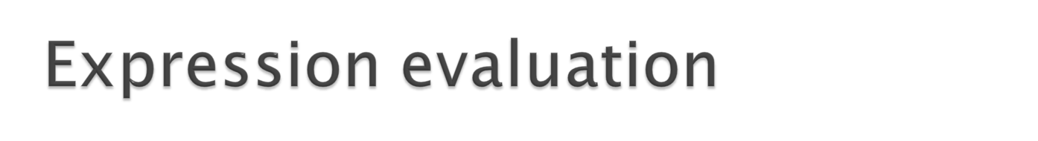
Summary (Contd.)
Infix expressions
  An operator appears between its operands
    Example: a + b
    Prefix expressions
    An operator appears before its operands
    Example: + a b
Postfix expressions
  An operator appears after its operands
    Example: a b +

Slide 60
To convert a fully parenthesized infix expression to a prefix form
  Move each operator to the position marked by its corresponding open parenthesis
  Remove the parentheses
  Example
    Infix expression: ( ( a + b ) * c )
    Prefix expression: * + a b c

Slide 61
To convert a fully parenthesized infix expression to a postfix form
  Move each operator to the position marked by its corresponding closing parenthesis
  Remove the parentheses
  Example
    Infix form: ( ( a + b ) * c )
    Postfix form: a b + c *

Slide 62
Prefix and postfix expressions
  Never need
    Precedence rules
    Association rules
    Parentheses
  Have
    Simple grammar expressions
    Straightforward recognition and evaluation algorithms

Slide 63
Evaluating an expression by using stacks:
  Stacks can be used to solve complex arithmetic expressions.
  The evaluation of an expression is done in two steps:
    Conversion of the infix expression into a postfix expression.
    Evaluation of the postfix expression.
Evaluating Expressions

Slide 64
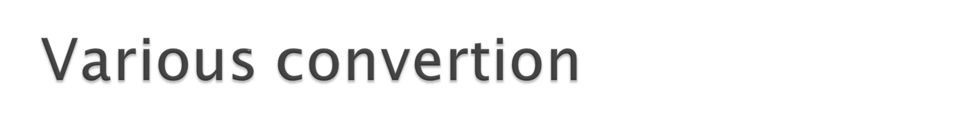
Infix to postfix
Infix to prefix
Prefix to infix
Prefix to postfix
Postfix to infix
Postfix to prefix
As done in class

Slide 65
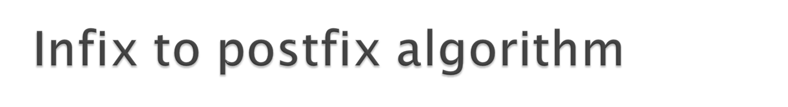

Slide 66
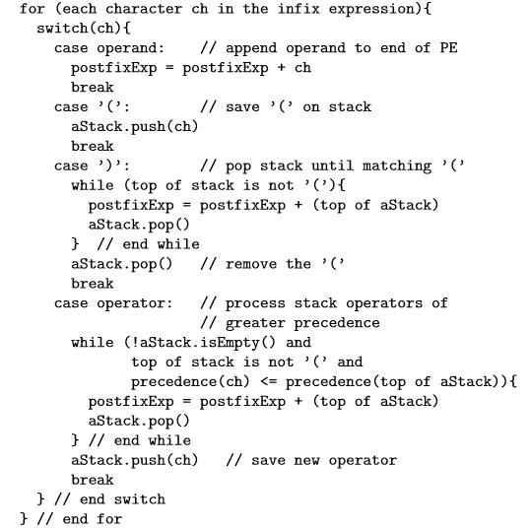

Slide 67
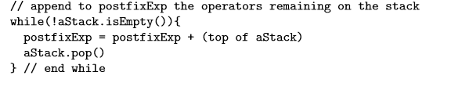

Slide 68
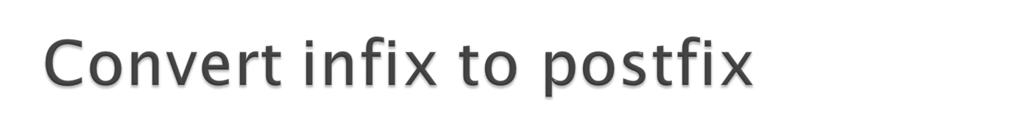
4-1%8+6%(3+1)*2+(4*(4+(2-5^2)))
5*(6+2)-12/4

Slide 69
Postfix : 418%631+%2*44252^-+*++-
Value : 75

Slide 70

Start with an empty stack.
We scan P from left to right.
While (we have not reached the end of P)
If an operand is found push it onto the stack End-If
If an operator is found
Pop the stack and call the value A
Pop the stack and call the value B
Evaluate B op A using the operator just found.
Push the resulting value onto the stack
End-If
End-While Pop the stack (this is the final value)

Slide 71
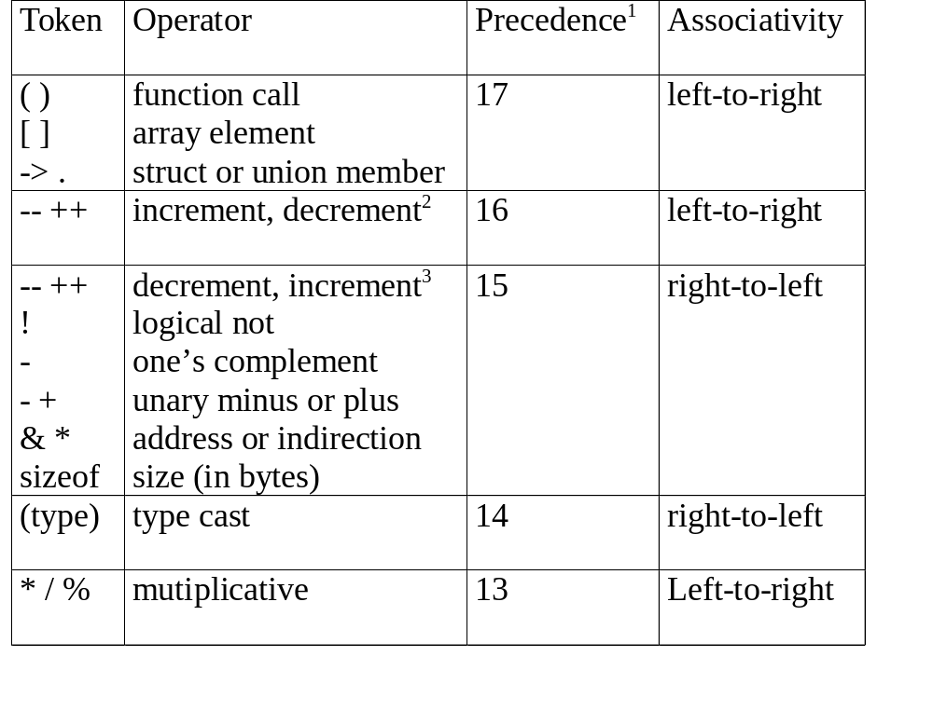
CHAPTER 3

Slide 72
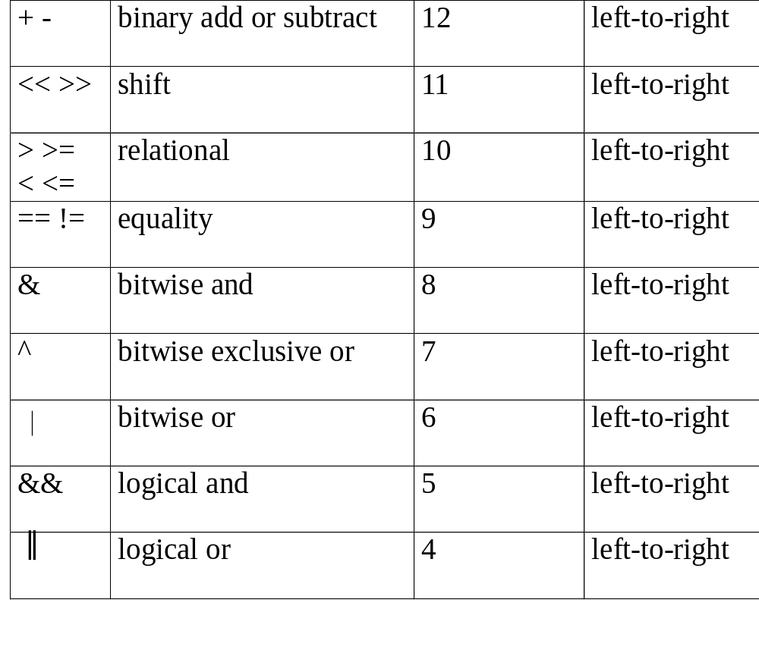
CHAPTER 3

Slide 73
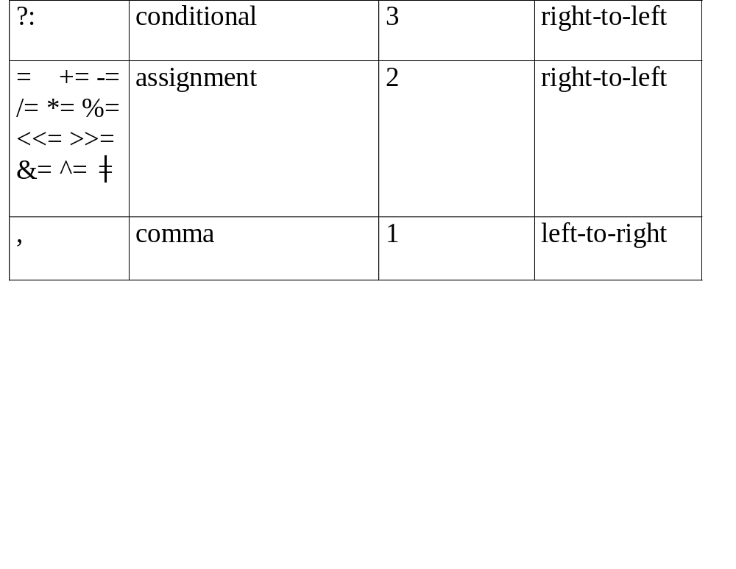
CHAPTER 3

Slide 74

Prefix &postfix

Slide 75
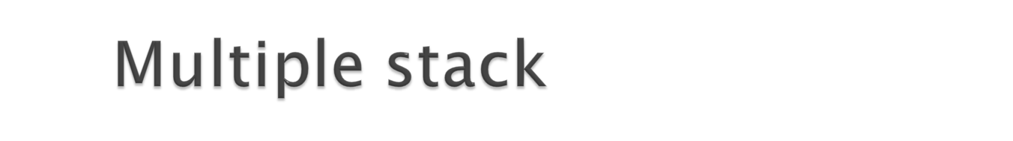
Several stack can be stored in a single array.
Suppose declare an array of
int a[15],
We have to create 3 stack of same size.
Lower bound of each array can be stored in array c
position of top of each stack can be stored in b[i].
for(i=0;i<n ; i++)
c[i]=((max/n)*i));
b[i]=c[i]-1;

Slide 76
Algorithm push(stackno,int h)
{ i=stackno
If(b[i]==c[i+1]-1 &&i!=n-1)
print “overflow”
else if(i==n-1 &&b[i]==max-1)
Print ”overflow”
else
{
b[i]=b[i]+1
a[b[i]]=h;
}

Slide 77
Algorithm pop(stackno)
{i=stackno
if(b[i]=c[i]-1)
write “underflow”
else
{
ele=a[b[i]]
Write “element deleted ele”
b[i]=b[i]-1
}

Slide 78
Algorithm Display(stackno)
i=stack no;
if(b[i]=c[i]-1)
Print(“no element’)
For(j=c[i];j<=b[i];j++)
write a[j]

Slide 79

Push-insertion at beginning
Pop-deletion from top
Diplay
Write the pseudo code for the same.

Slide 80


